Slide 1
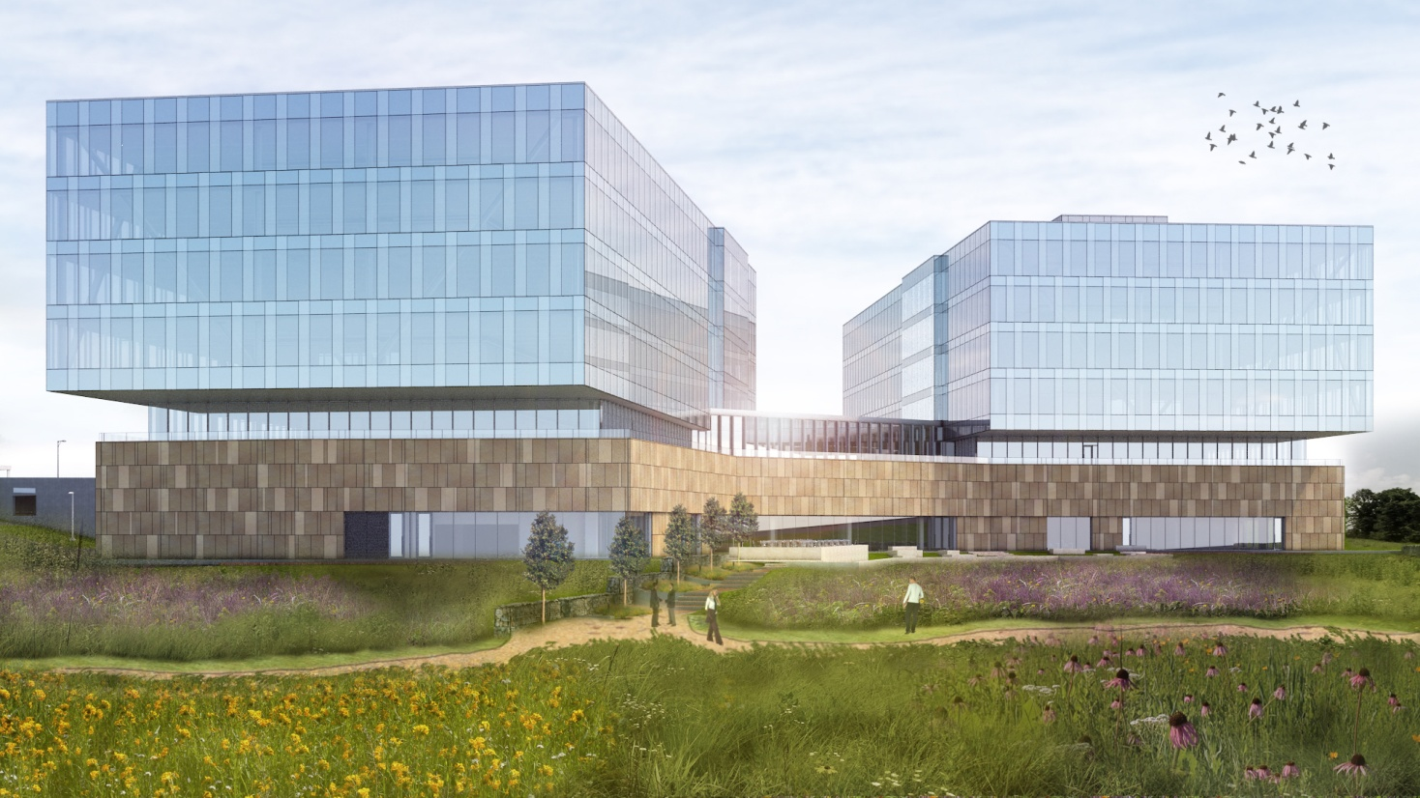
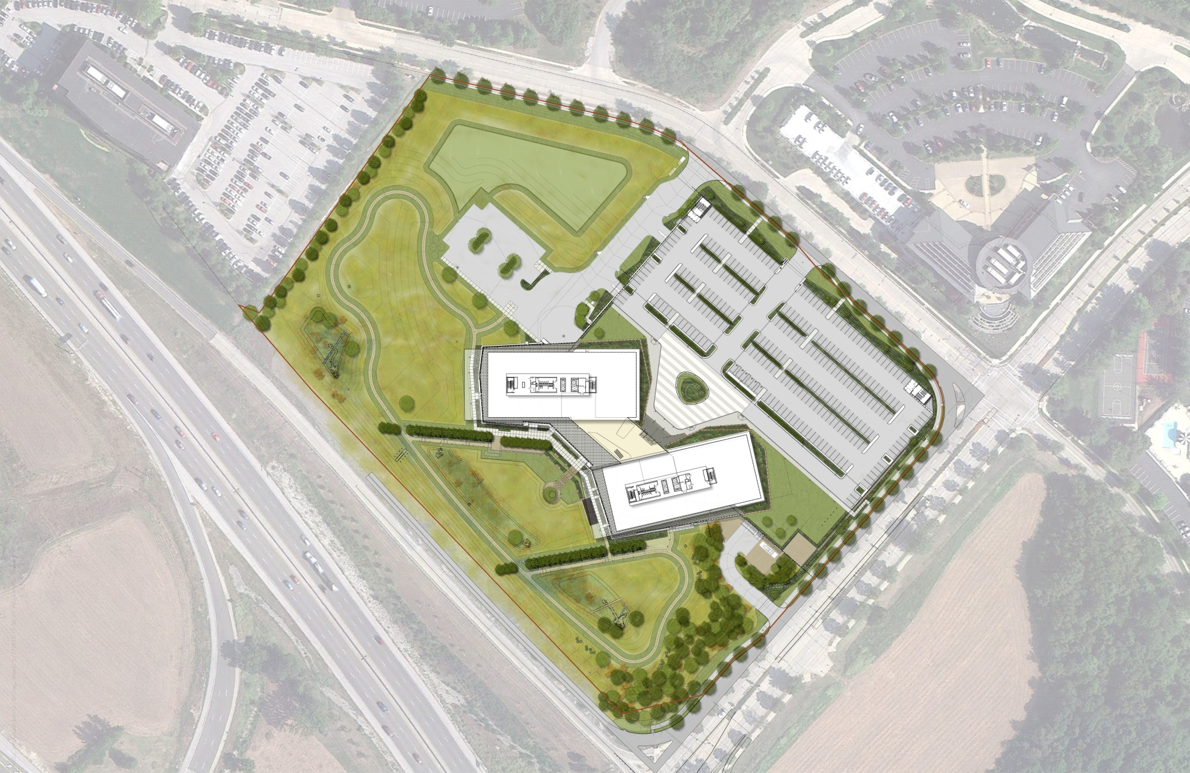
Reinsurance Group of
America (RGA) Global Headquarters
Natasha Beck
Structural Option
Faculty Advisor: Heather Sustersic
N
Images courtesy of Gensler & Tom Rolfes

Slide 2
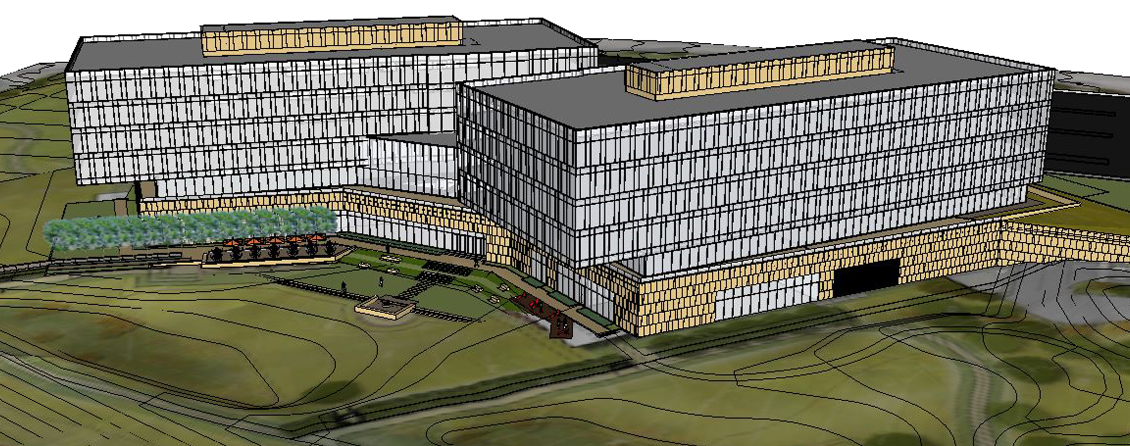
Occupancy: General office and training
Construction: March 2013 to September 2014
Delivery: Design-Build
2 Parking Levels
5 Office Levels per Tower
RGA Global Headquarters
Introduction
Project Team:
General Contractor: Clayco
Architect: Gensler
Structural Engineer: Uzun & Case
Civil Engineer: Stock & Associates
Landscape Architect: Forum Studio
Lighting Consultant: Randy Burkett Lighting Design
MEP/Fire Protection: Environmental Systems Design
Size: 405,000 GSF
Cost: Approx. $150 million
Introduction
Problem Statement & Solution
Green Roof Garden Breadth
Structural Depth
Gravity System
Lateral System
Construction Breadth Results
Conclusions
Acknowledgements
Model courtesy of Gensler & Tom Rolfes

Slide 3
RGA Global Headquarters
Problem Statement & Solution
+172% Dead
+355% Live
+112% Dead
+118% Live
Scenario:
Owner has decided to incorporate a green roof
garden that is open to RGA’s employees
Thesis Study Goals:
Interdisciplinary green roof design
Revise gravity and lateral systems under green roof loading
Explore cost and schedule impact
Introduction
Problem Statement & Solution
Green Roof Garden Breadth
Structural Depth
Gravity System
Lateral System
Construction Breadth Results
Conclusions
Acknowledgements
Model courtesy of Gensler & Tom Rolfes

Slide 4
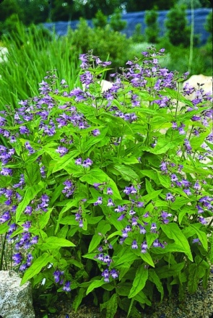
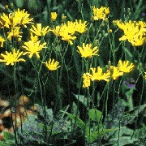
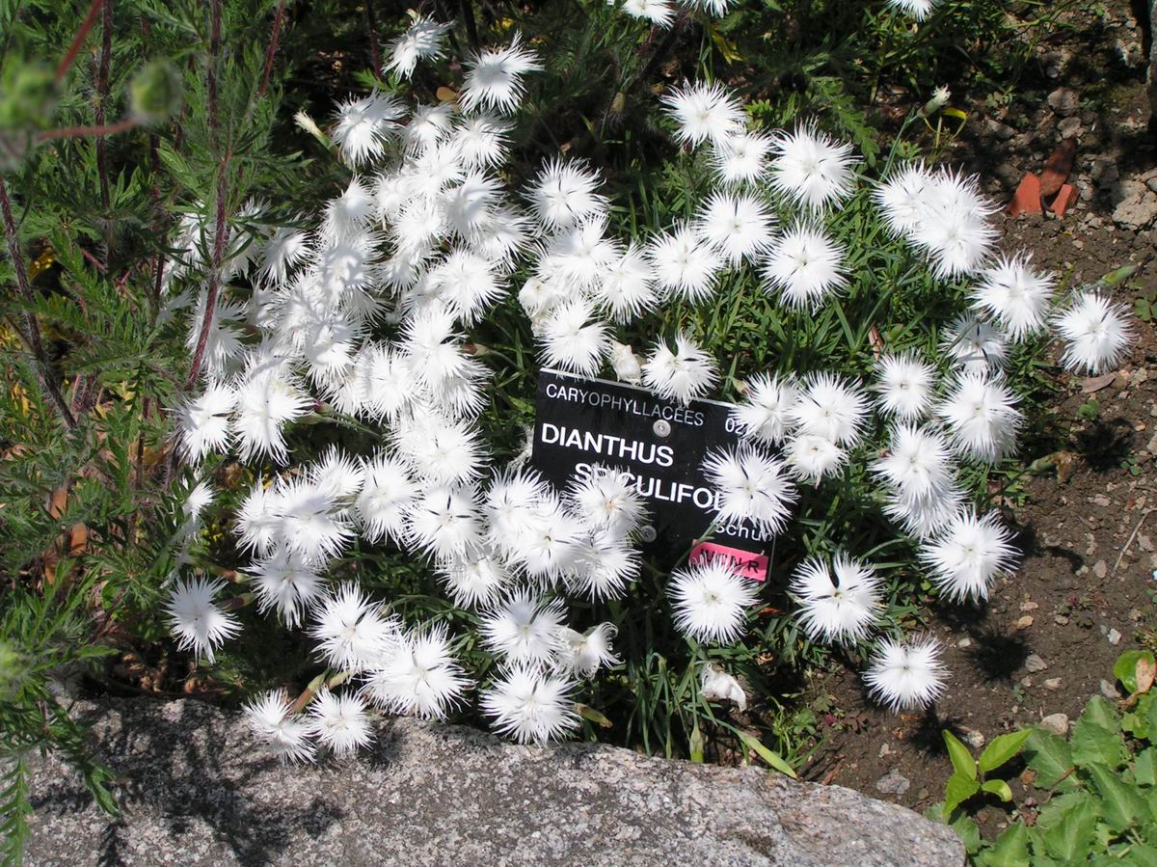
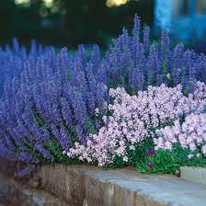
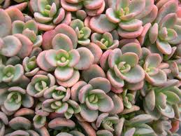
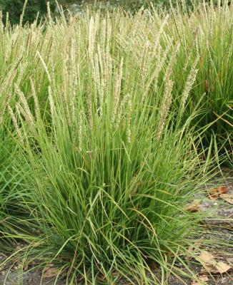
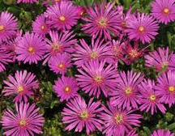
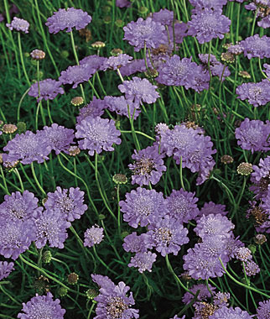
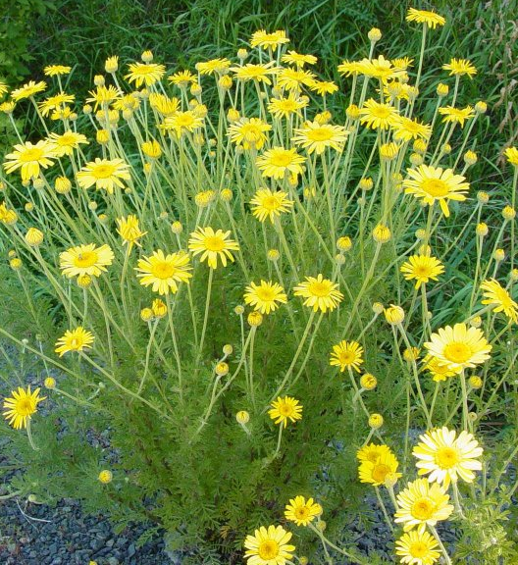
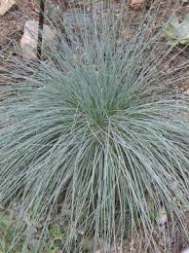
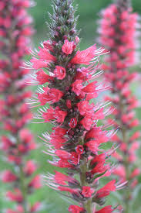
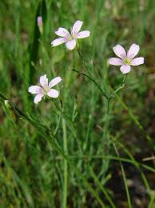
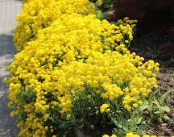
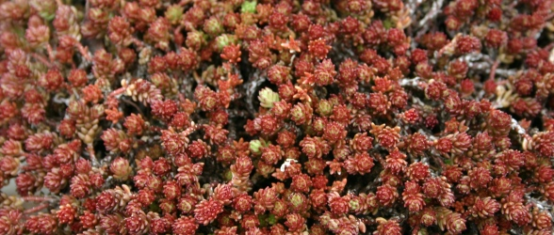
RGA Global Headquarters
Green Roof Garden Breadth
Introduction
Problem Statement & Solution
Green Roof Garden Breadth
Structural Depth
Gravity System
Lateral System
Construction Breadth Results
Conclusions
Acknowledgements
Sedums
Garden Plants
Wildflower Plants

Slide 5
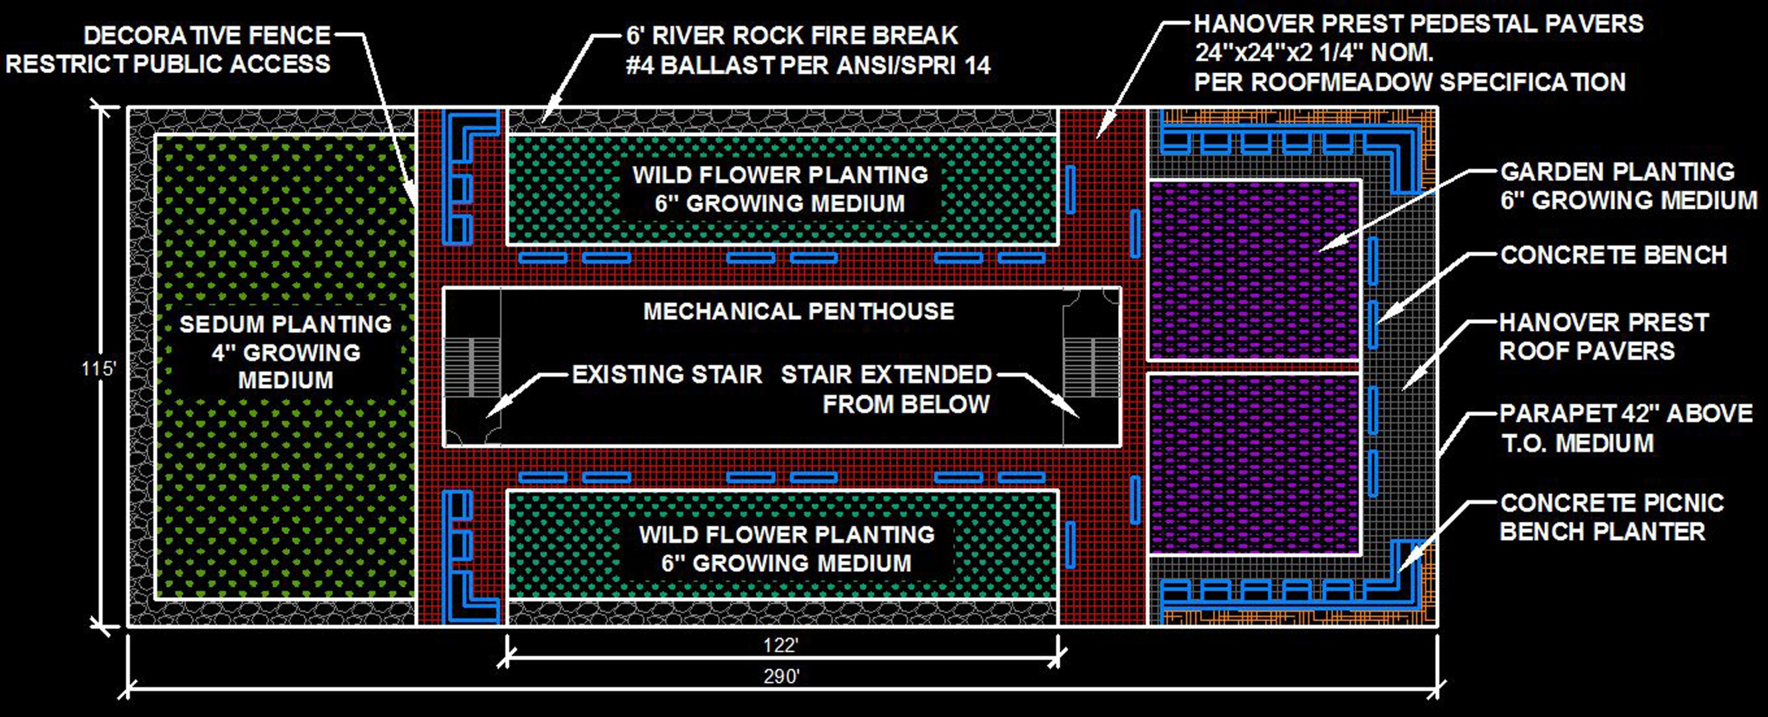
RGA Global Headquarters
Green Roof Garden Breadth
Introduction
Problem Statement & Solution
Green Roof Garden Breadth
Structural Depth
Gravity System
Lateral System
Construction Breadth Results
Conclusions
Acknowledgements
Interdisciplinary Design Requirements:
Reasonable initial cost
Amenity seating area
Tenant circulation
Low maintenance
Architectural lines are uninterrupted
N
Layout

Slide 6
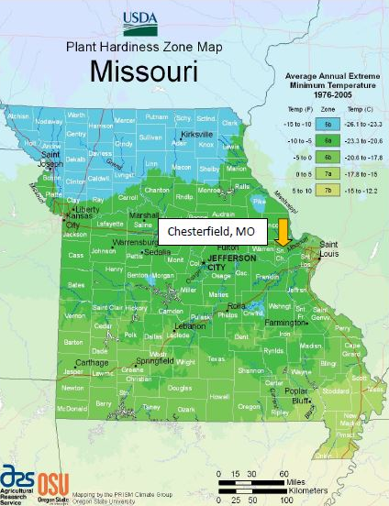
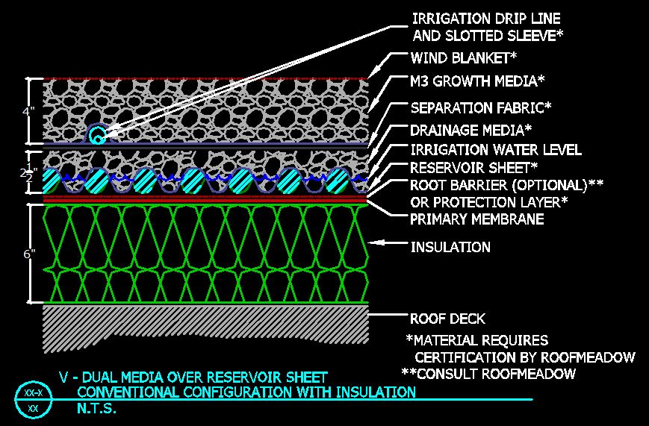
Structural Load Cases
6” Growing Medium:
RGA Global Headquarters
Green Roof Garden Breadth
4” Growing Medium:
Dead: 68 PSF
Roofmeadow Type V System
Dead: 53 PSF
Water Live: 34 PSF
Water Live: 26 PSF
Roof Live: 20 PSF
Introduction
Problem Statement & Solution
Green Roof Garden Breadth
Structural Depth
Gravity System
Lateral System
Construction Breadth Results
Conclusions
Acknowledgements
Roof Live: 20 PSF
Public Live: 100 PSF
Snow: 22 PSF
Snow: 22 PSF
Wind: -21 PSF
Wind: -21 PSF
Dead: +112%
Dead: +172%
Live: +118%
Live: +355%

Slide 7
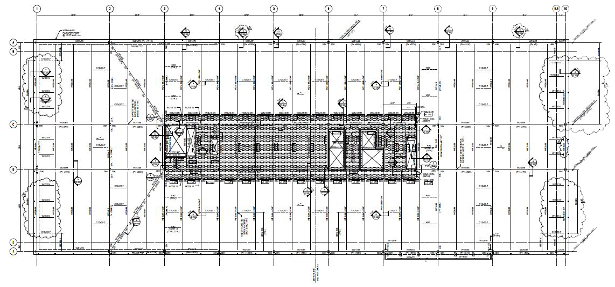
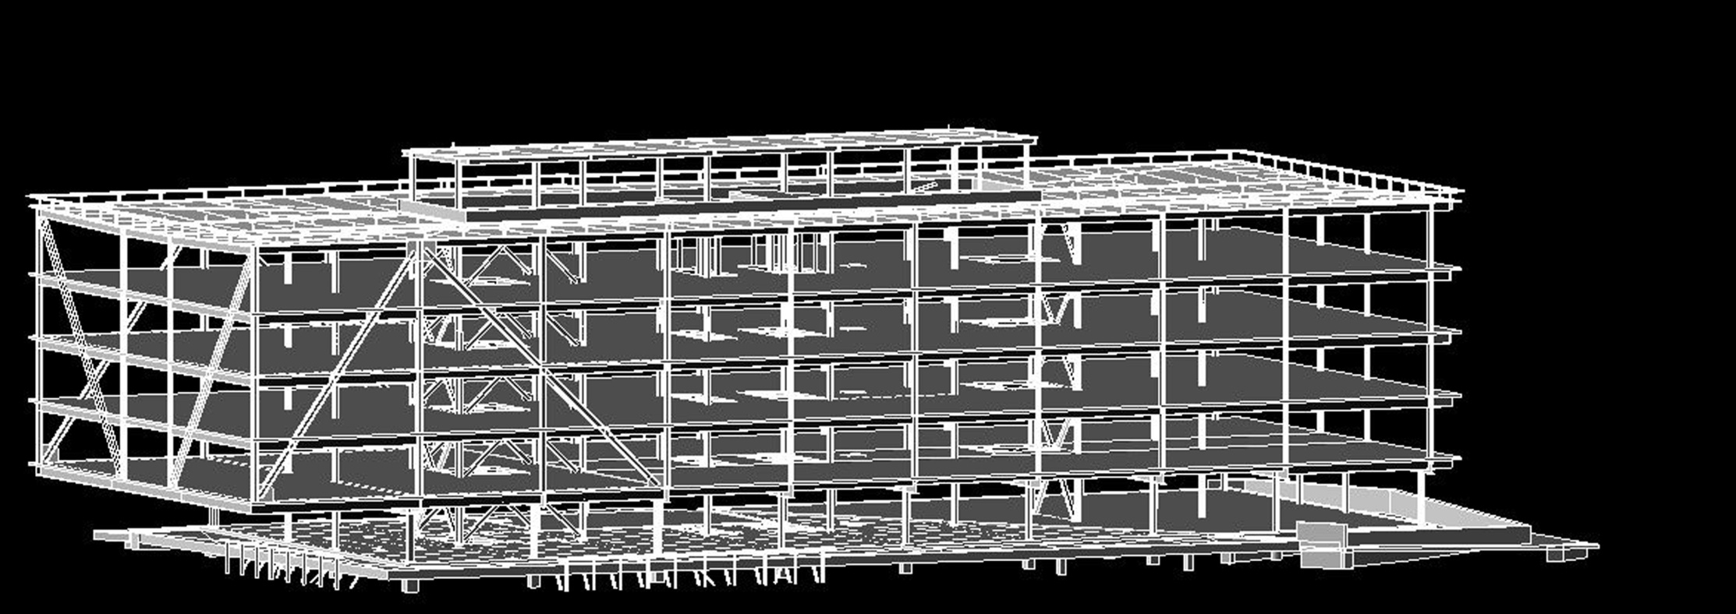
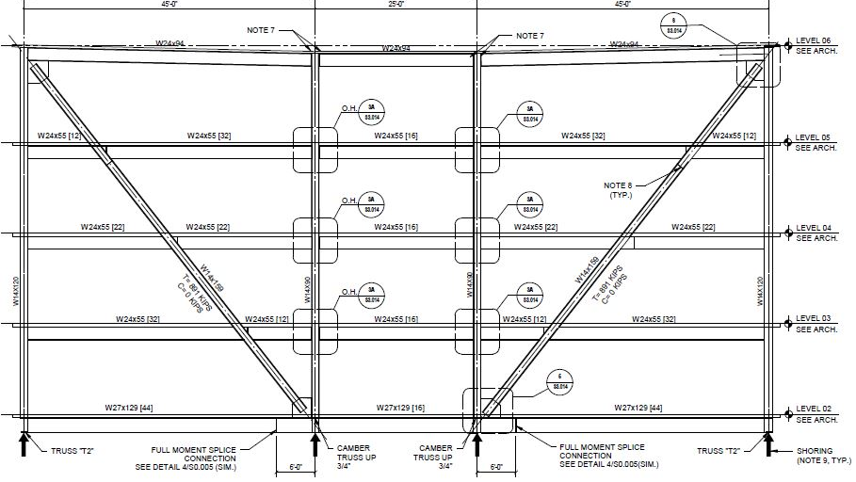
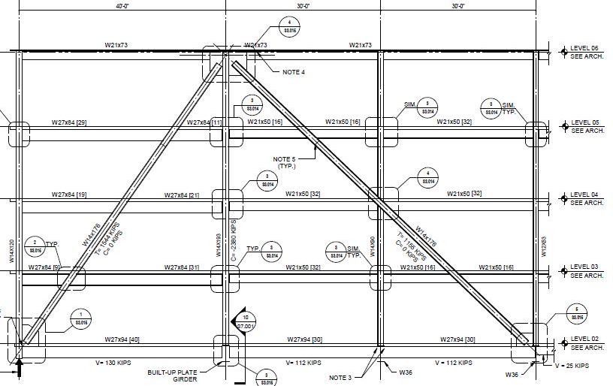
RGA Global Headquarters
Structural Depth
Existing Gravity System
Built Up Plate Girder Level 02
Cambered Truss System
Introduction
Problem Statement & Solution
Green Roof Garden Breadth
Structural Depth
Gravity System
Lateral System
Construction Breadth Results
Conclusions
Acknowledgements
From C.D.
Roof Framing
N
From C.D.
Truss T1
From C.D.
Truss T2

Slide 8
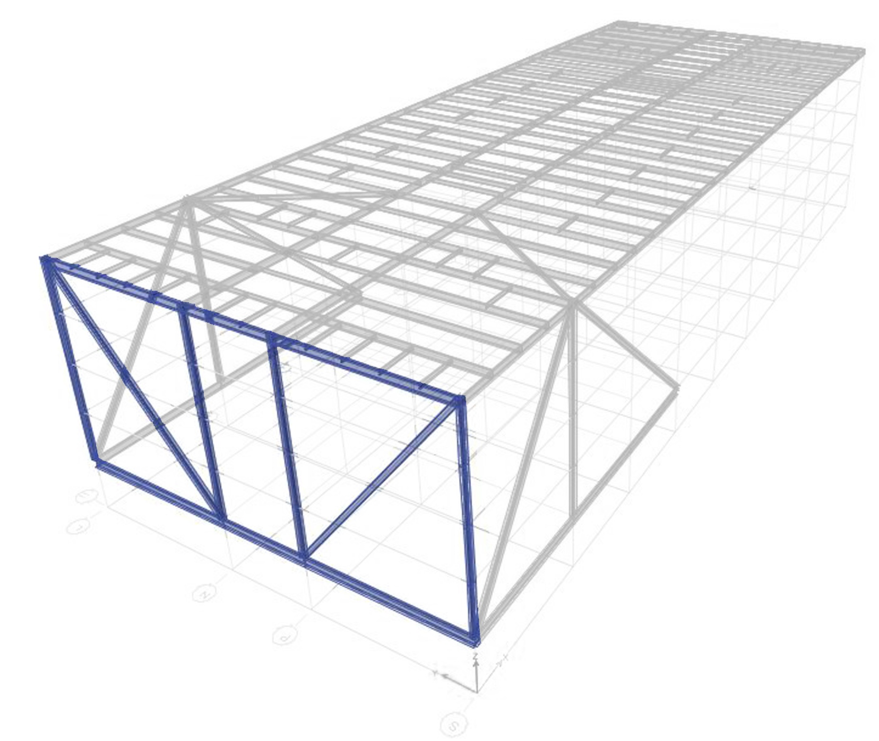
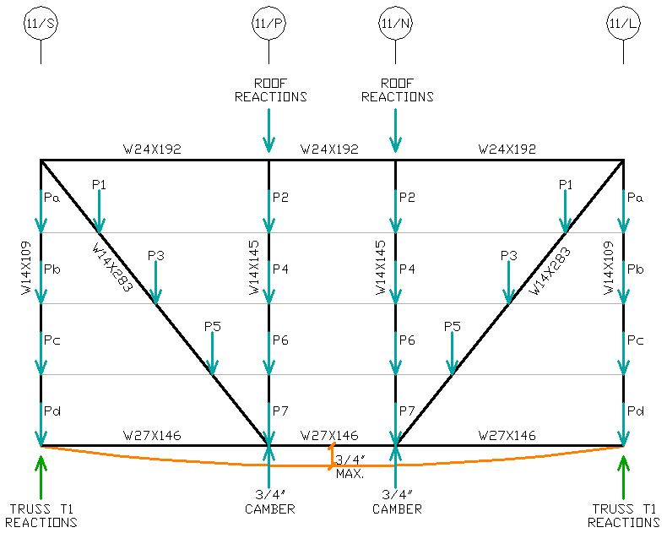
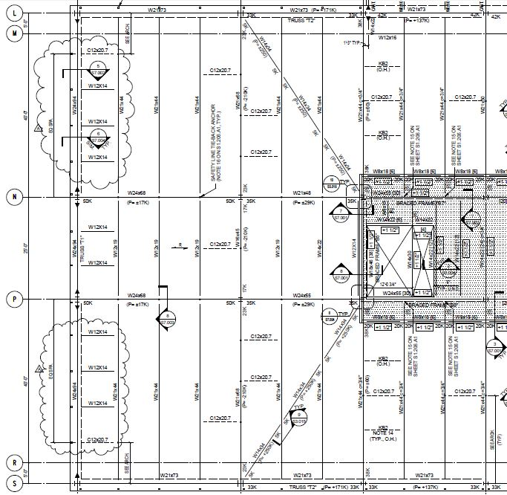
RGA Global Headquarters
Structural Depth
From C.D.
Introduction
Problem Statement & Solution
Green Roof Garden Breadth
Structural Depth
Gravity System
Lateral System
Construction Breadth Results
Conclusions
Acknowledgements
Truss T1:
Roof Reactions
Floor Gravity
Reactions on T2
Deflection < ¾”

Slide 9
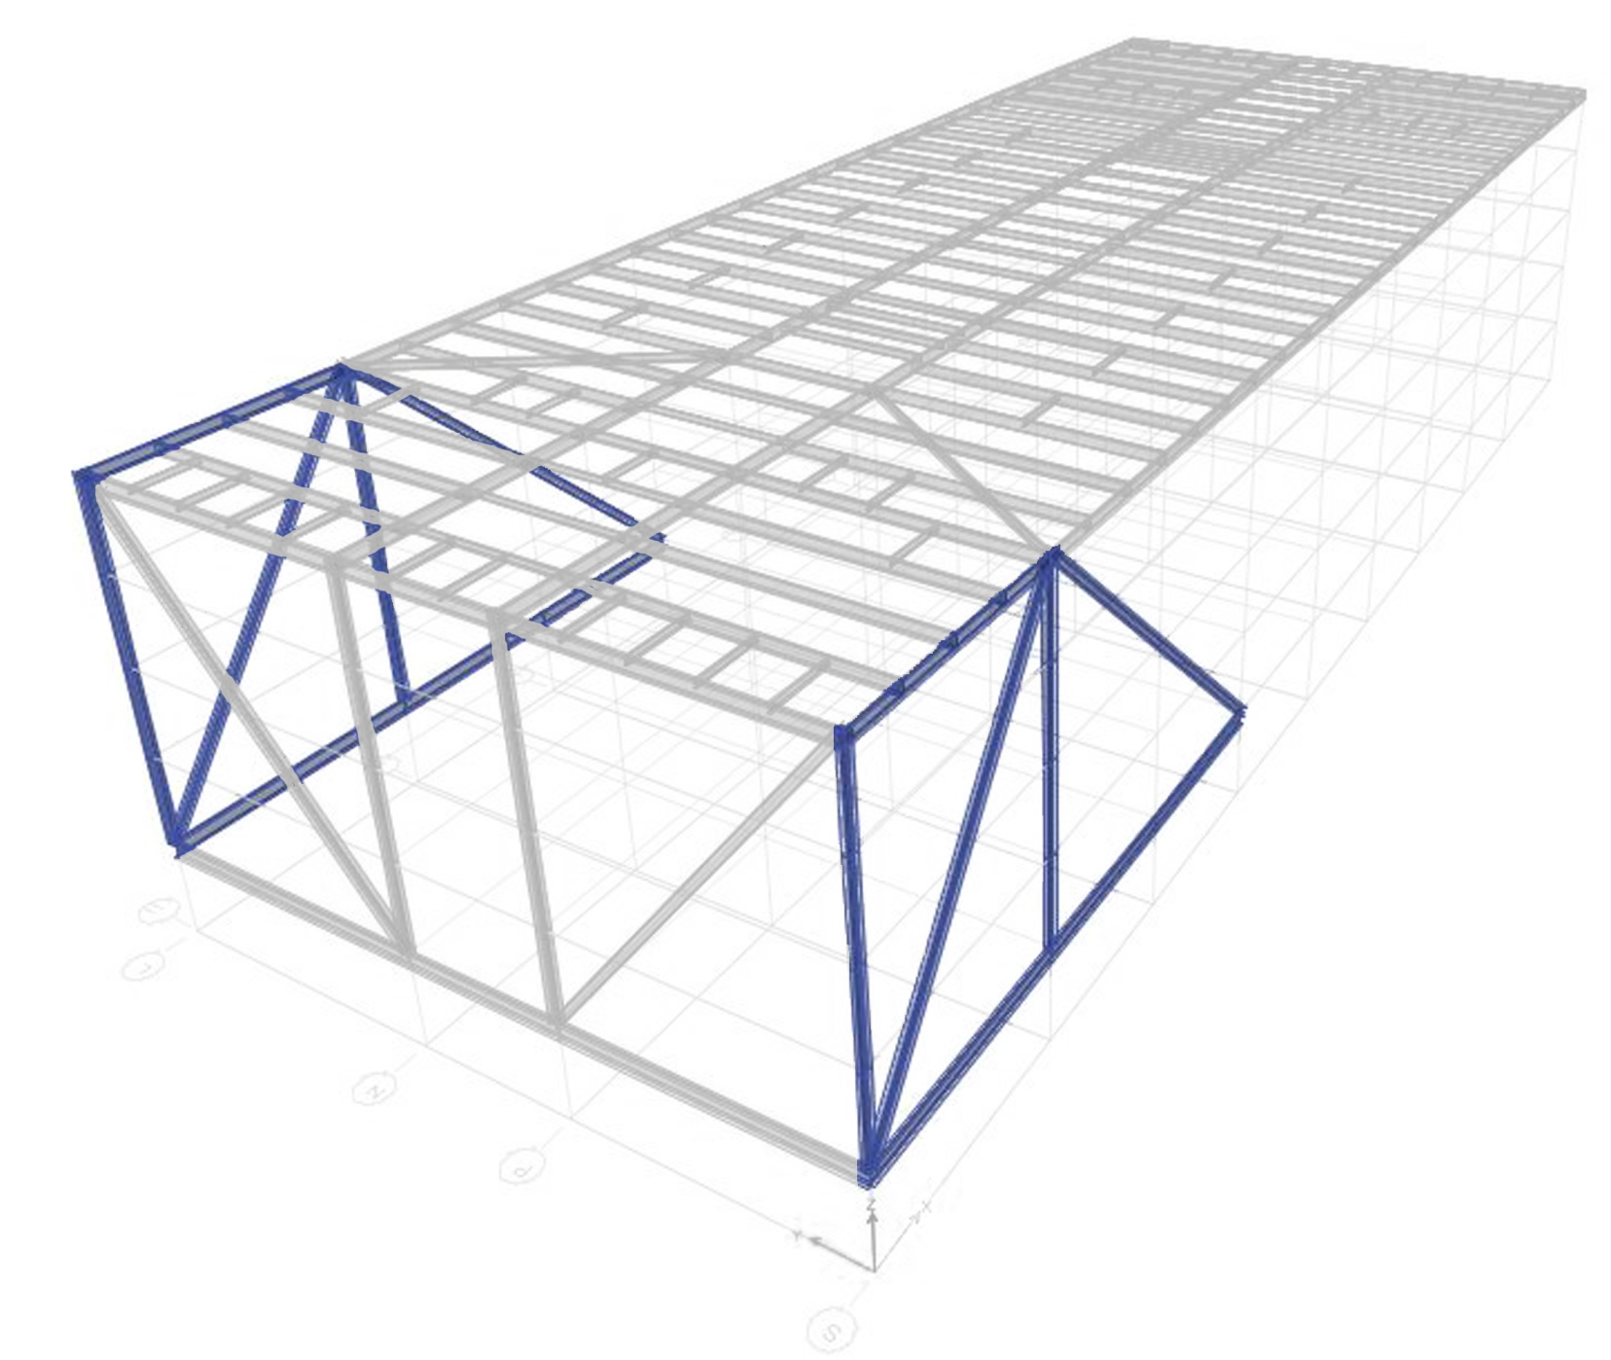
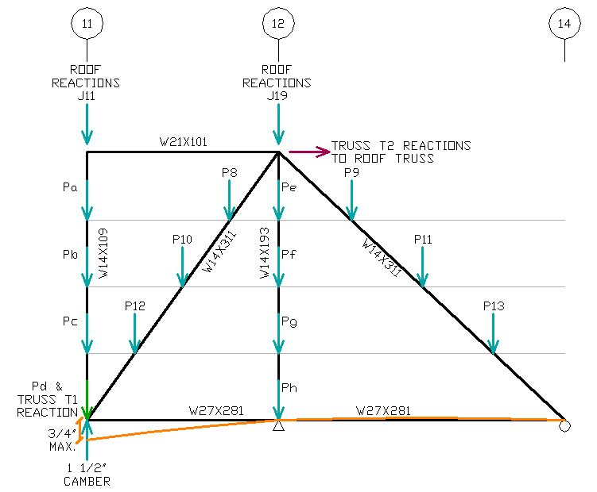
RGA Global Headquarters
Structural Depth
From C.D.
Introduction
Problem Statement & Solution
Green Roof Garden Breadth
Structural Depth
Gravity System
Lateral System
Construction Breadth Results
Conclusions
Acknowledgements
Truss T2:
Roof Reactions
T1 Reactions
Floor Gravity
Reactions to Roof
Deflection < ¾”

Slide 10
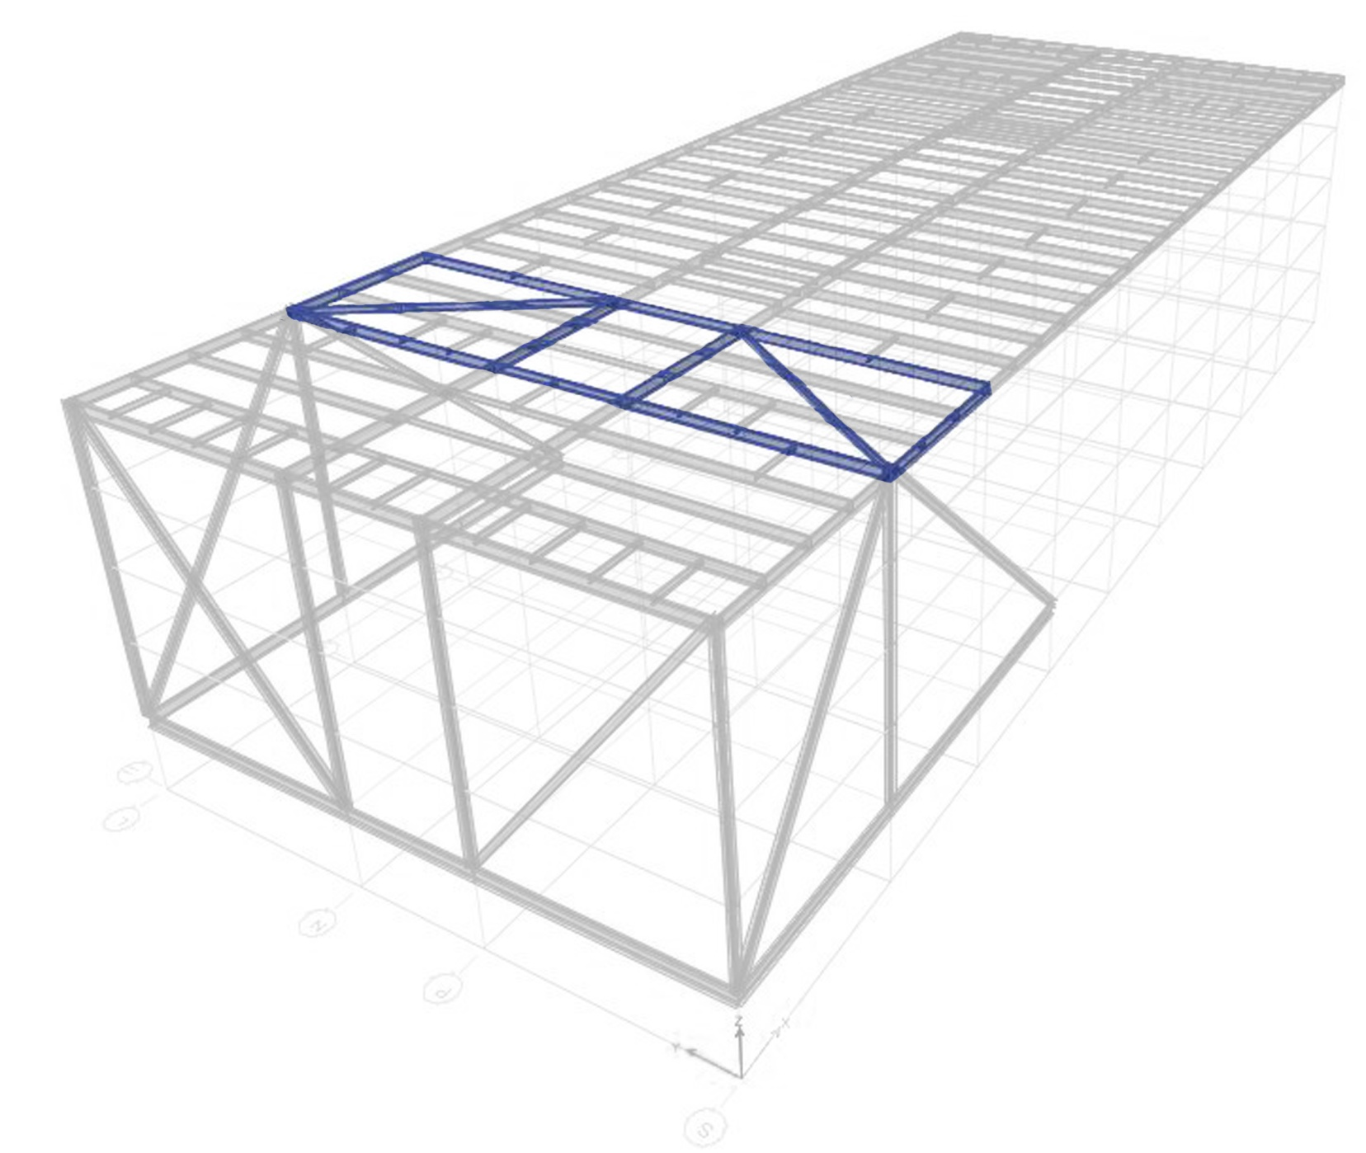
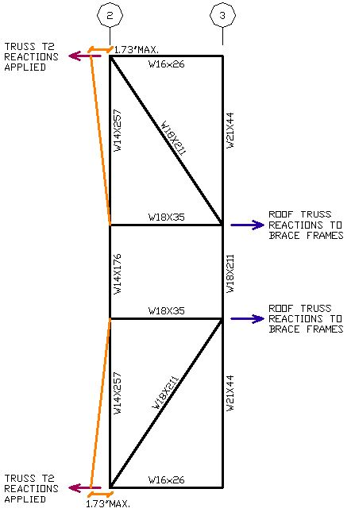
RGA Global Headquarters
Structural Depth
From C.D.
Introduction
Problem Statement & Solution
Green Roof Garden Breadth
Structural Depth
Gravity System
Lateral System
Construction Breadth Results
Conclusions
Acknowledgements
Roof Truss:
T2 Reactions
Reactions to BFs
Deflection < 1.73”

Slide 11
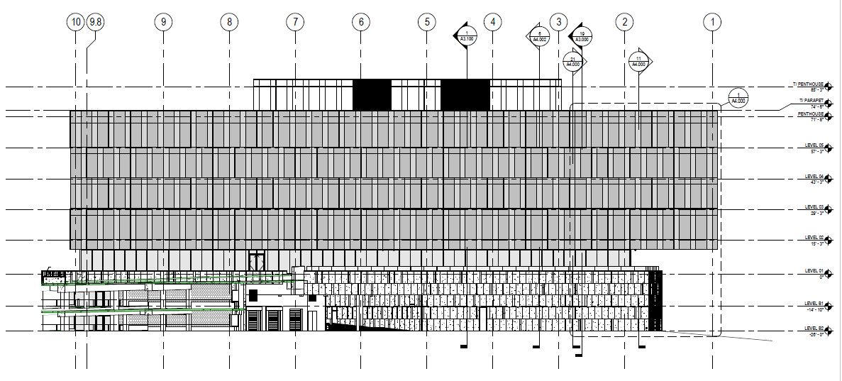
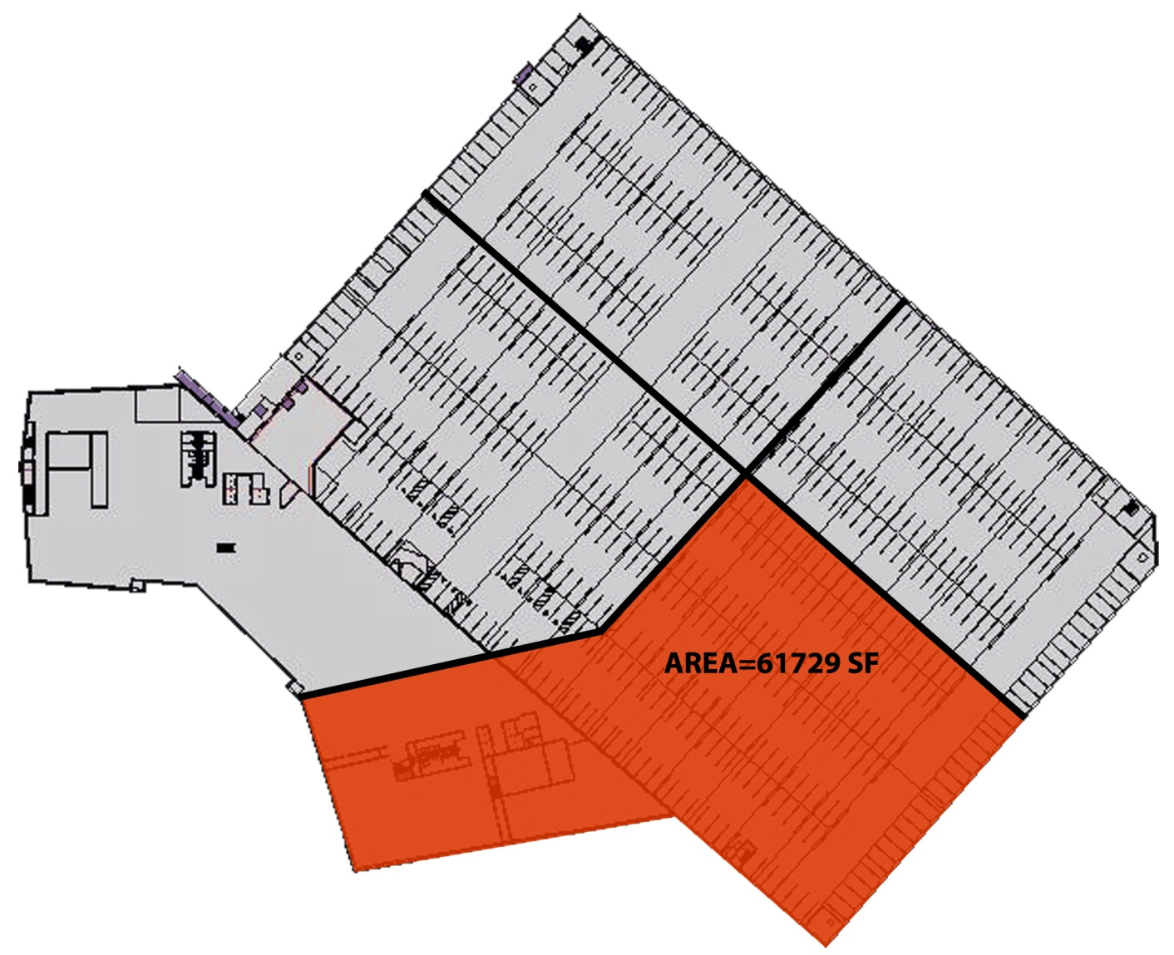
RGA Global Headquarters
Structural Depth
Existing Lateral System
Two Stage Procedure
Introduction
Problem Statement & Solution
Green Roof Garden Breadth
Structural Depth
Gravity System
Lateral System
Construction Breadth Results
Conclusions
Acknowledgements
Steel Braced Frames
Concrete Shear Walls
Scope
Model courtesy of Gensler & Tom Rolfes
From C.D.

Slide 12
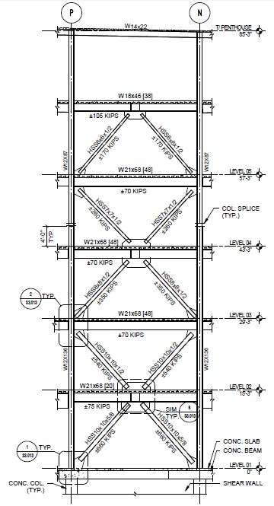
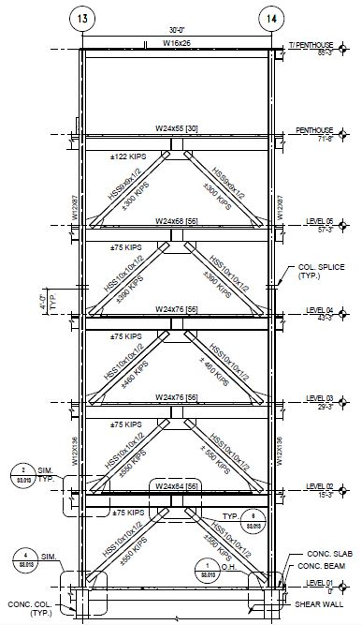
RGA Global Headquarters
Structural Depth
Existing Layout:
Concentrically Braced Frames
HSS Braces
R = 3
Introduction
Problem Statement & Solution
Green Roof Garden Breadth
Structural Depth
Gravity System
Lateral System
Construction Breadth Results
Conclusions
Acknowledgements
From C.D.
N
BF 5 & 6
From C.D.
BF 7 & 8

Slide 13
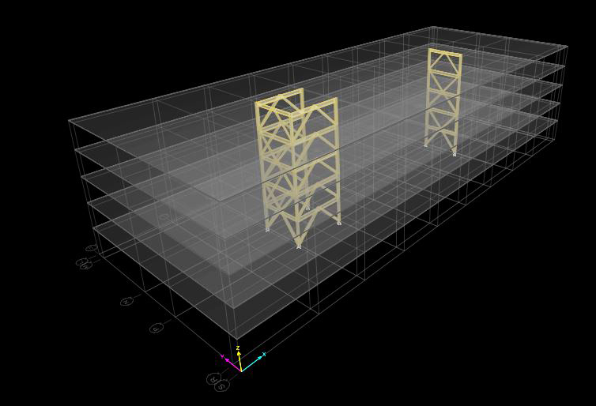
RGA Global Headquarters
Structural Depth
ETABS Model
Seismic Force Adjustments:
Assume Seismically Detailed R = 7
Two stage procedure impact
Introduction
Problem Statement & Solution
Green Roof Garden Breadth
Structural Depth
Gravity System
Lateral System
Construction Breadth Results
Conclusions
Acknowledgements
New Response
R = 7
As-Built: R = 3
New Period
Ta = 8.42 sec.
As-Built: 0.561 s
New Office Base Shear
V = 323 k
As-Built: V = 3338 k
New Ratio
1.75
As-Built: 1.0
New Structure Base Shear
V = 1552 k
As-Built: V = 4235 k

Slide 14
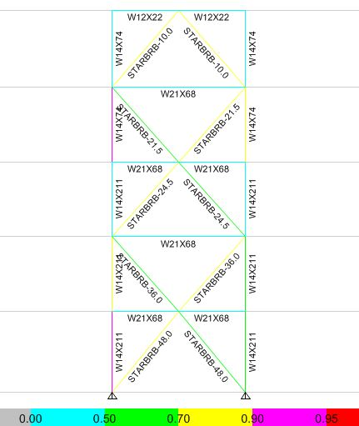
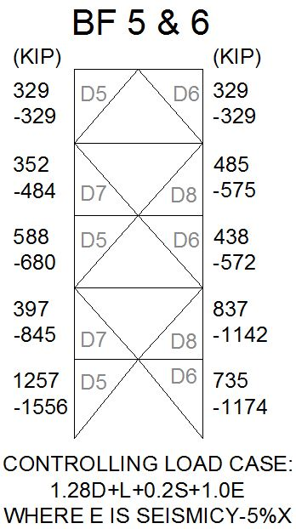
BF 5 & 6
Member Sizes &
Code Check
RGA Global Headquarters
Structural Depth
Controlling load combination:
(1.2 + 0.2SDS) D + ρQE + L + 0.2S
From ASCE 7-05 12.4.2.3
Introduction
Problem Statement & Solution
Green Roof Garden Breadth
Structural Depth
Gravity System
Lateral System
Construction Breadth Results
Conclusions
Acknowledgements
SDC C
I = 1.25
ρ = 1.0
SDS = 0.400
R = 7
Cd = 5.5
Fy = 46 ksi
Controlling Frame Design Forces
For Preliminary Sizing
STARBRB-36.0 =
Buckling-Restrained Brace with 36 sq. in. steel core area

Slide 15
RGA Global Headquarters
Construction Breadth
Roof System & Supporting Structure Cost Summary:
As-Built Project : $1,717,700
$60.38 per SF
Green Roof : $5,774,600
$202.97 per SF
Introduction
Problem Statement & Solution
Green Roof Garden Breadth
Structural Depth
Gravity System
Lateral System
Construction Breadth Results
Conclusions
Acknowledgements
Includes:
10% Overhead and Profit
4% Missouri Sales Tax
5% Contingency
Location
Time

Slide 16
RGA Global Headquarters
Conclusions
Thesis Study Conclusions:
Green roof designed with interdisciplinary approach
Implications on gravity and lateral systems considered and minimized where possible
Accounted for cost and schedule factors
System Conclusions:
Green roof garden system is feasible
Cantilever impact minimized
Buckling-restrained braces work, but are not most efficient in this application
Cost and schedule increase reasonable, but final decision rests in the owner’s hands
Introduction
Problem Statement & Solution
Green Roof Garden Breadth
Structural Depth
Gravity System
Lateral System
Construction Breadth Results
Conclusions
Acknowledgements
Model courtesy of Gensler & Tom Rolfes

Slide 17
RGA Global Headquarters
Acknowledgements
Introduction
Problem Statement & Solution
Green Roof Garden Breadth
Structural Depth
Gravity System
Lateral System
Construction Breadth Results
Conclusions
Acknowledgements
Heather Sustersic
Ruby+Associates
Perry Esslinger & Tom Rolfes with Clayco
Family, Friends, God
Images courtesy of Gensler & Tom Rolfes

Slide 18
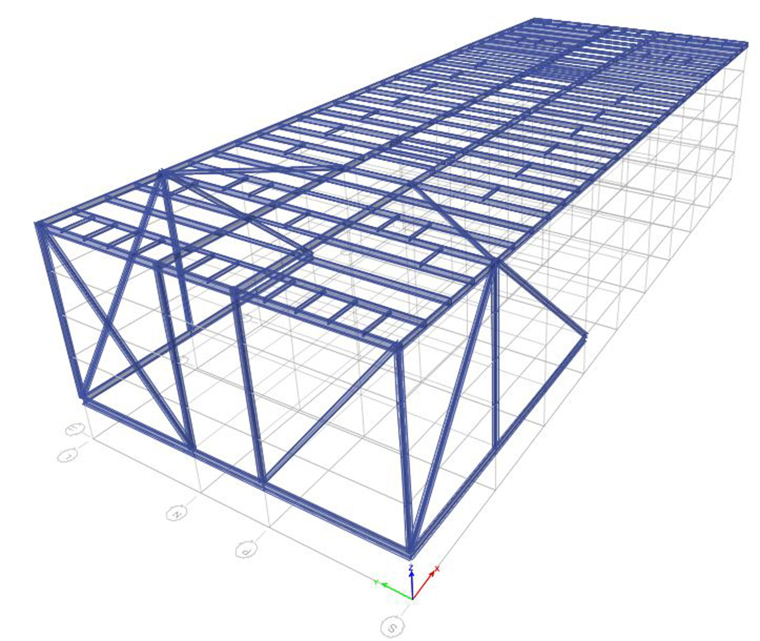
RGA Global Headquarters
Questions?
Introduction
Problem Statement & Solution
Green Roof Garden Breadth
Structural Depth
Gravity System
Lateral System
Construction Breadth Results
Conclusions
Acknowledgements
Model courtesy of Gensler & Tom Rolfes

